Slide 1
diamonds price prediction system
Done by:
Anas Nofal
Bisan Abu-Musbeh
Shaimaa Iqtefan

Slide 2
Farming the problem
Our model is:
supervised learning : the training set is labeled
regression :we want to predict numerical data
Batch learning: all the training will be done offline

Slide 3
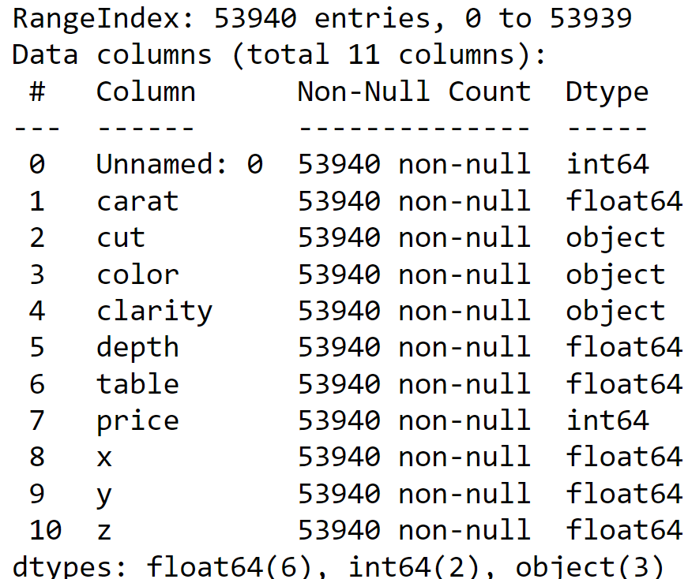
Exploring the data
It is A data frame with 53940 rows and 10 variables with 3 object type of data and 8 numerical data also there is no missing data as shown in the null count section

Slide 4
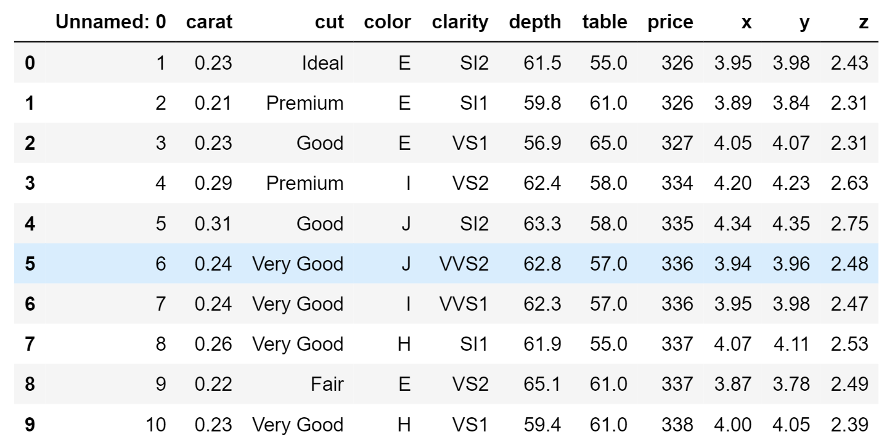
A quick look at the data

Slide 5
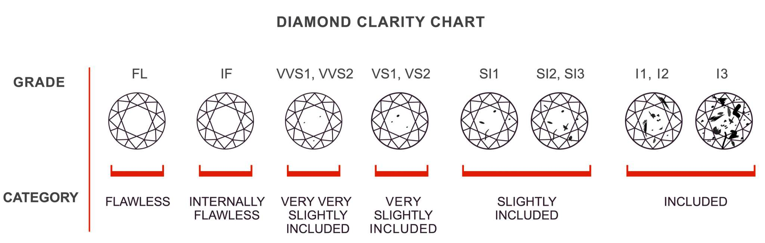
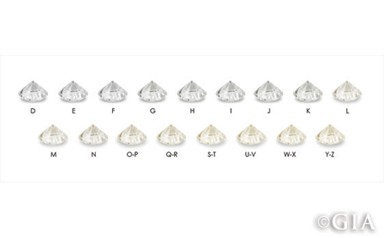
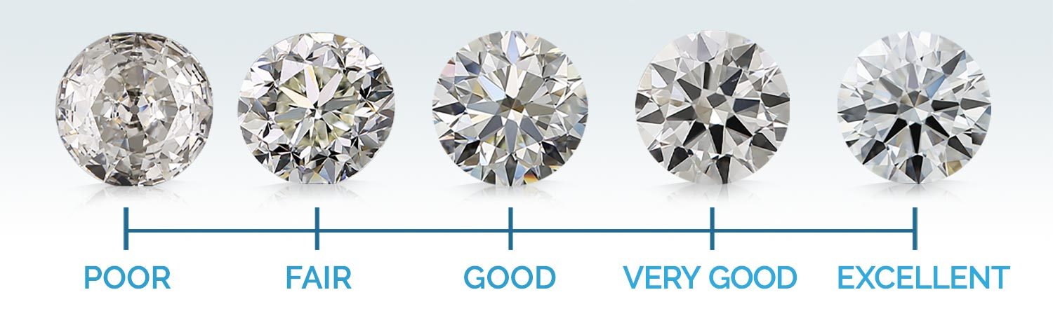
Clarity
Color
Cut

Slide 6
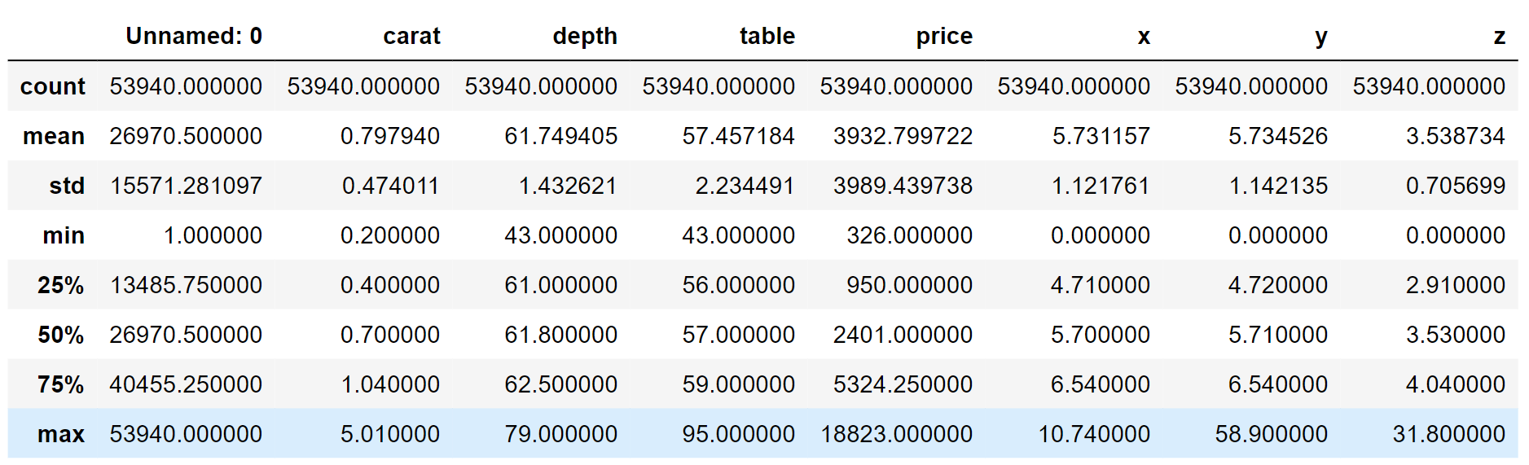
when we look at the minimum values we notice some zeros in the x, y,z columns so that means there is missing data in x y z columns

Slide 7
Data Visualization

Slide 8
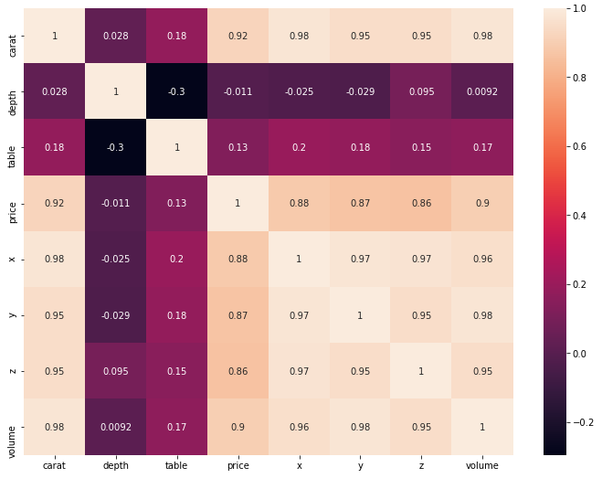
Correlation between all numerical columns using Heatmap
There is strong correlation between:
carat , price
carat ,volume

Slide 9
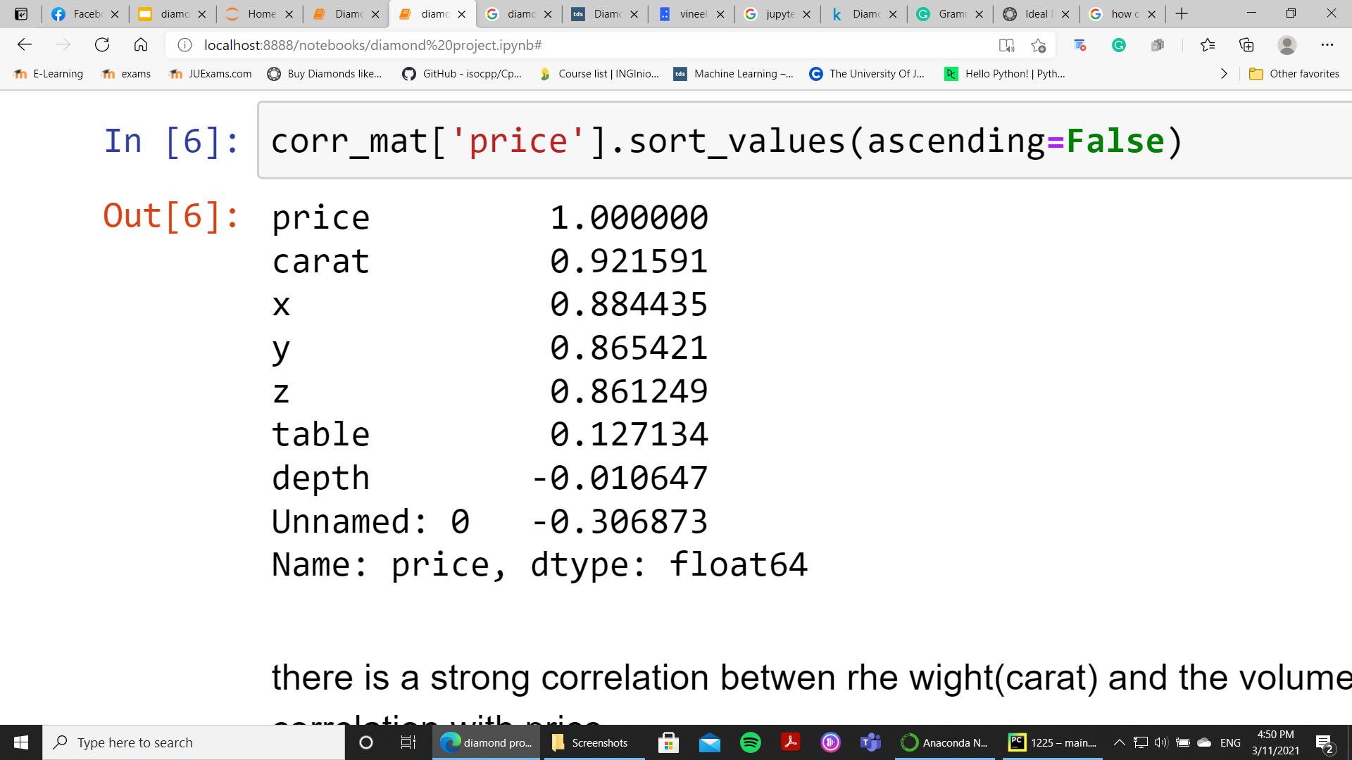
The correlation between price and the numerical features
there is a strong correlation between the weigh(carat) and the volume (x,y,z) with the price and It is recognizable here that depth and table have a very weak correlation with price.

Slide 10
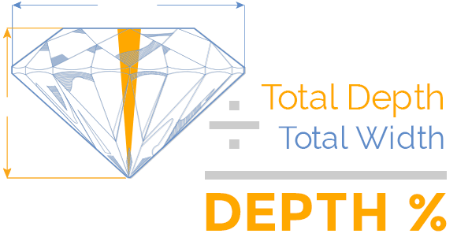
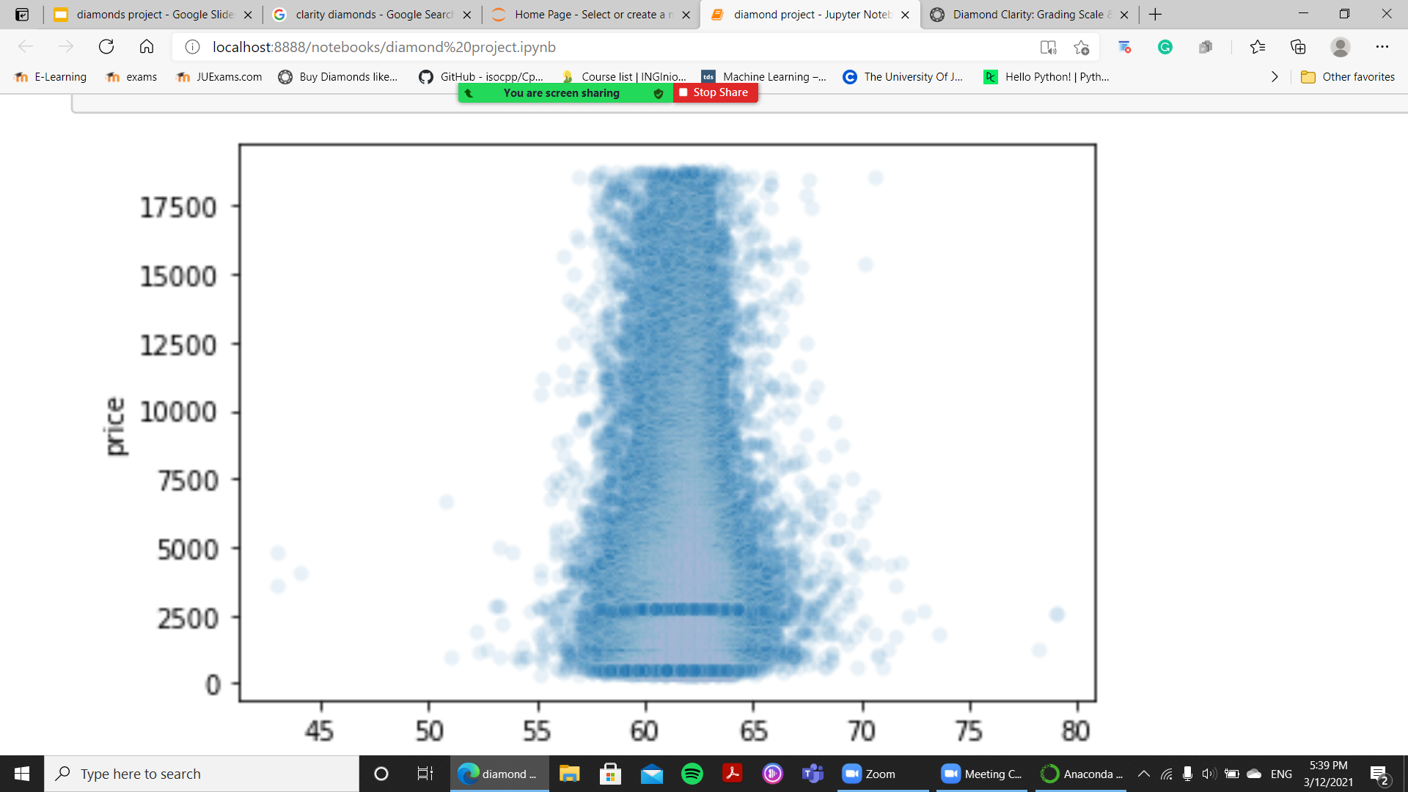
Correlation between depth and price columns using scatter plot
depth total depth percentage = z / mean(x, y) = 2 * z / (x + y)
according to experts, the depth is deemed acceptable within a certain range, with any value between 56.5 and 65 percent considered good.
However, the ideal depth is between 59.5 and 62.9 percent. and as shown in the plot the highest price diamonds is between 60 and 64

Slide 11
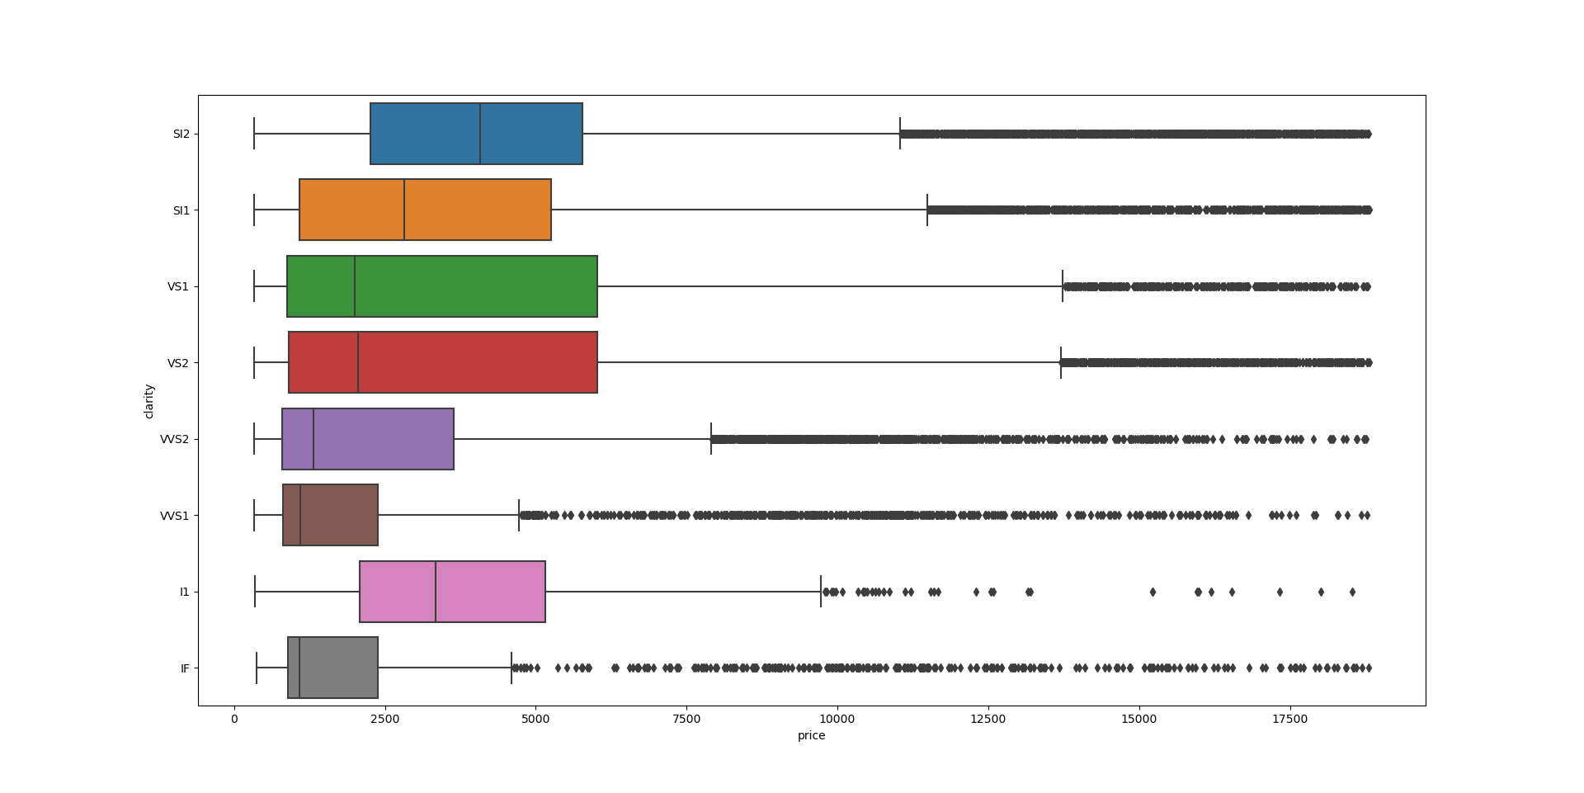
Plotting the categorical features with price using box plot
If is the highest clarity level so they must be the most expensive but when you look at the plot you will find that it has the less price.

Slide 12
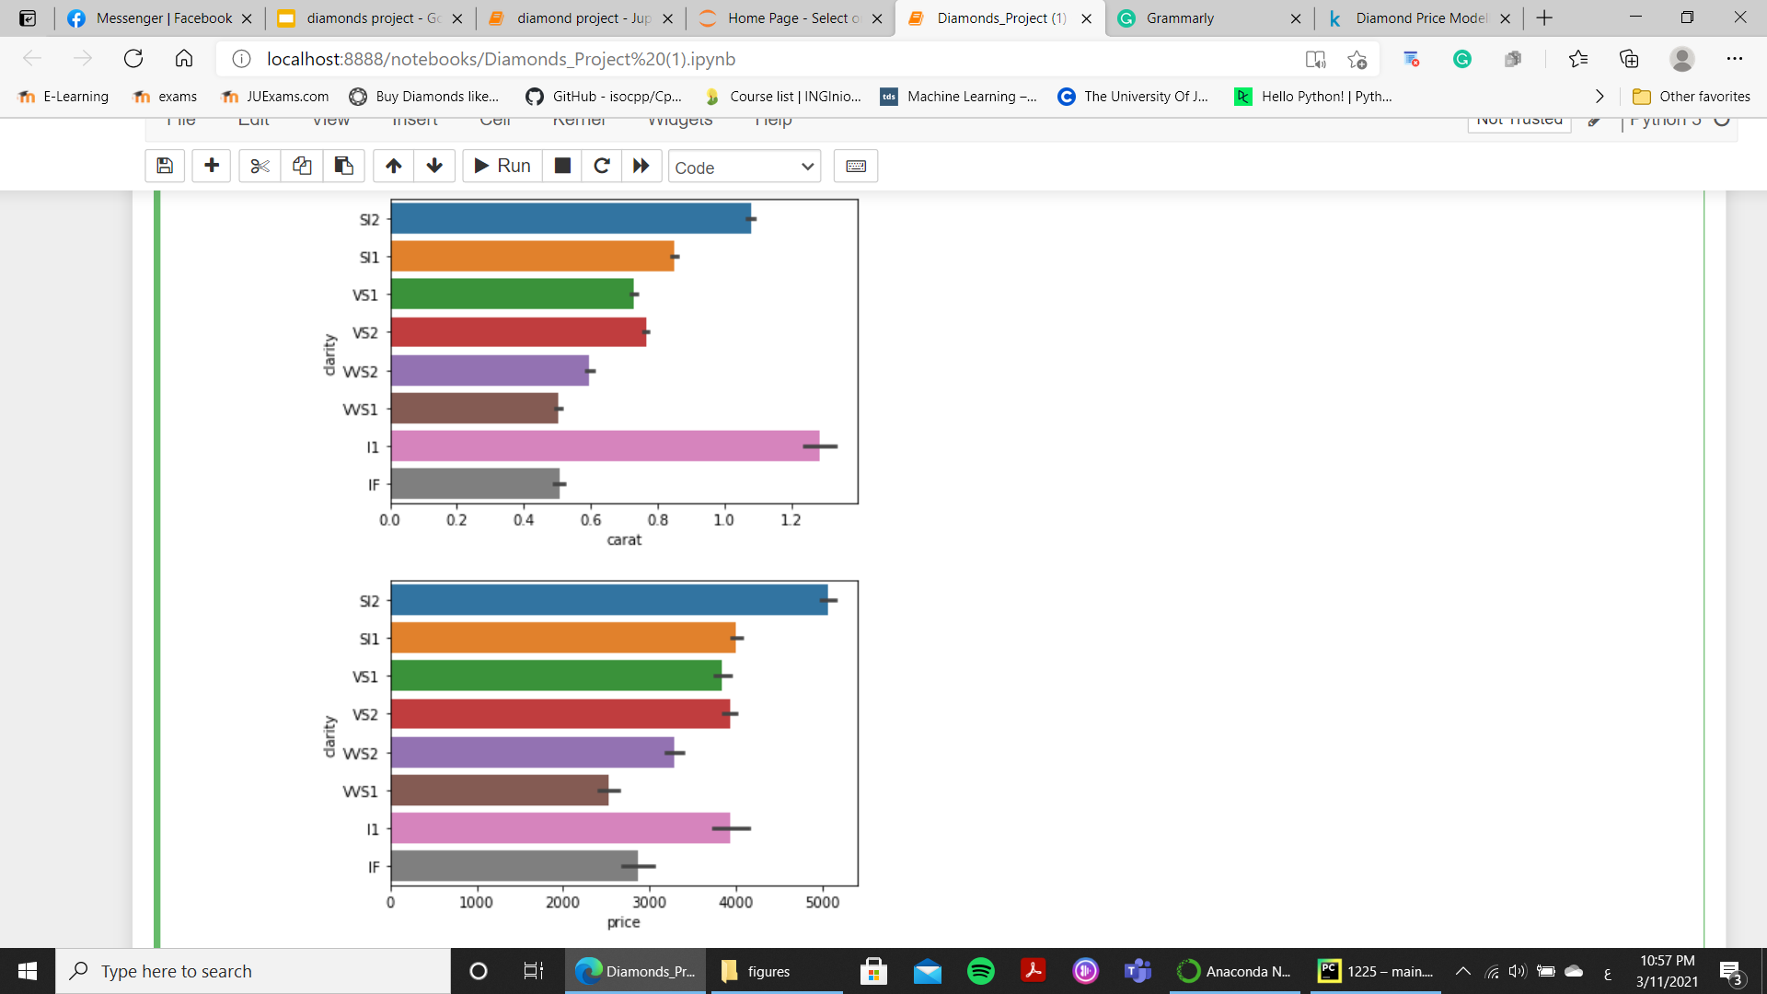
Clarity
I1 diamonds weigh the most, but they are not the most expensive; SI2 are. The price of a diamond can fairly be relative to its clarity, to some extent.

Slide 13
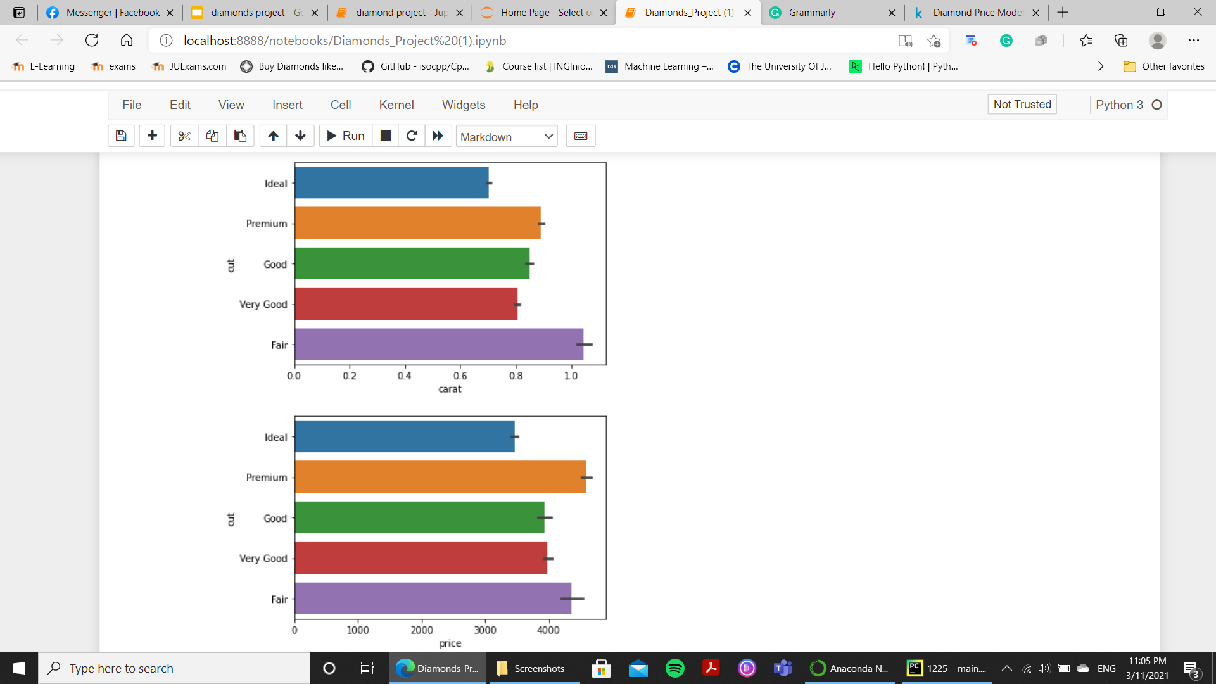
cut
Fair cuts have the most weight (carat), but they are not the most expensive diamonds. Though premium cuts weigh less than the fair ones they cost more. Ideal cuts weigh way less and they are the least expensive. The cut, therefore, is relatively considered while determining the price of the diamond.

Slide 14
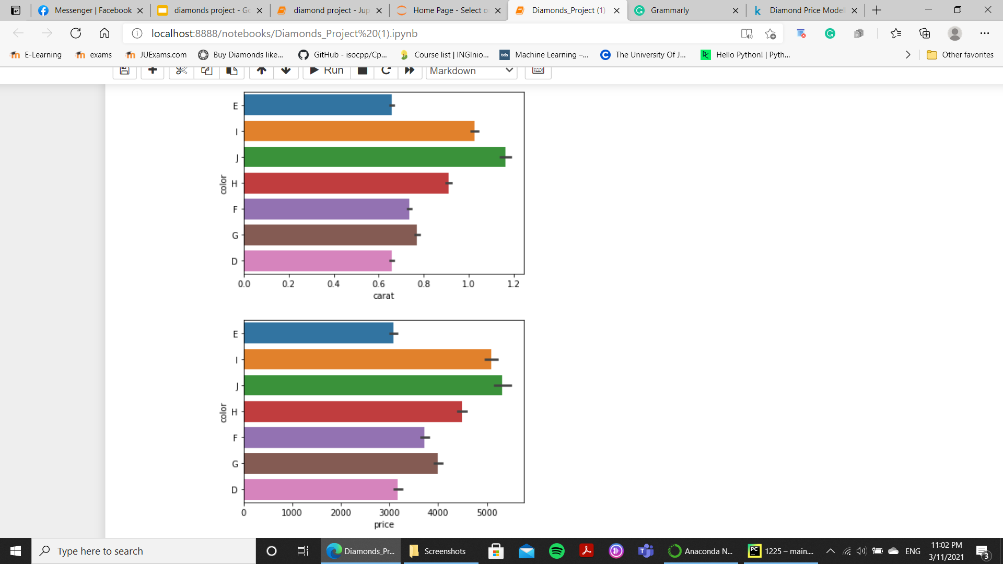
color
Diamonds with color J have the most weight (carat) and also the most price. The least expensive diamonds are ones with E and D colors which also have the less weight. The last 2 plots are very similar. It can be seen here that the color of the diamond is also very dependent on its price.

Slide 15
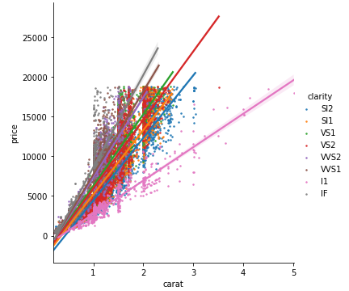
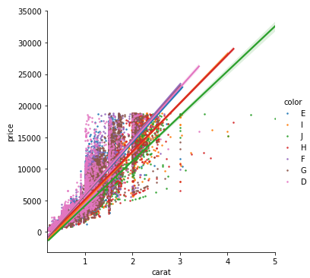
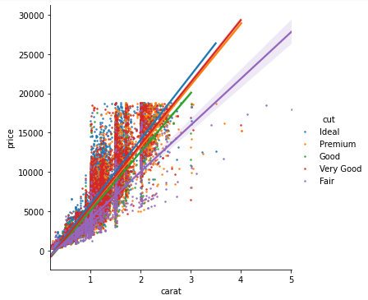
plotting the carat and price based on the categorical feature
when plotting the categorical data with the price it is hard to notice the effect so we plot the carat and price based on the categorical feature

Slide 16
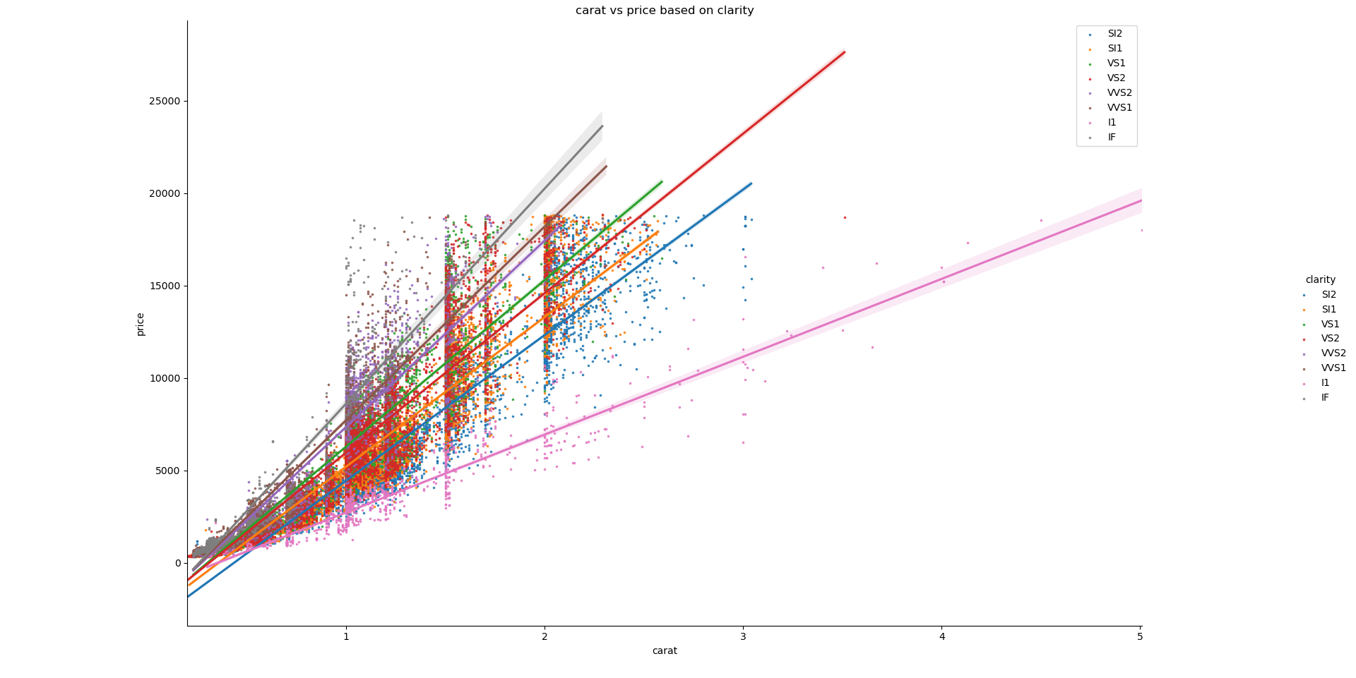
let us zoom the correlation

Slide 17
Data cleaning and preparing

Slide 18
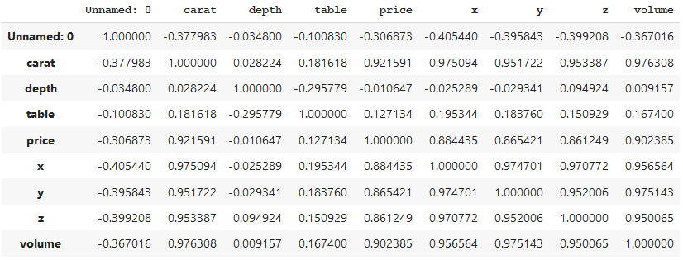
attribute combinations
We created volume column which is multiplication of x,y,z columns. The correlation between volume and price is higher than it with the x,y,z

Slide 19
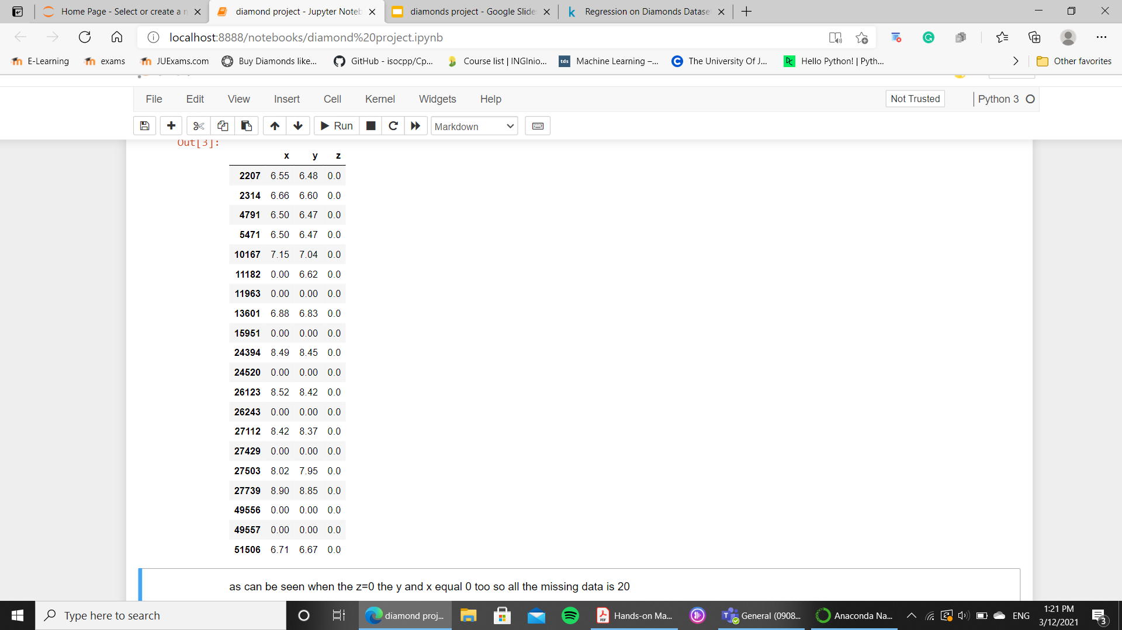
A look at the missing data
as can be seen when the z=0 the y and x equal 0 too so all the missing data is 20.

Slide 20
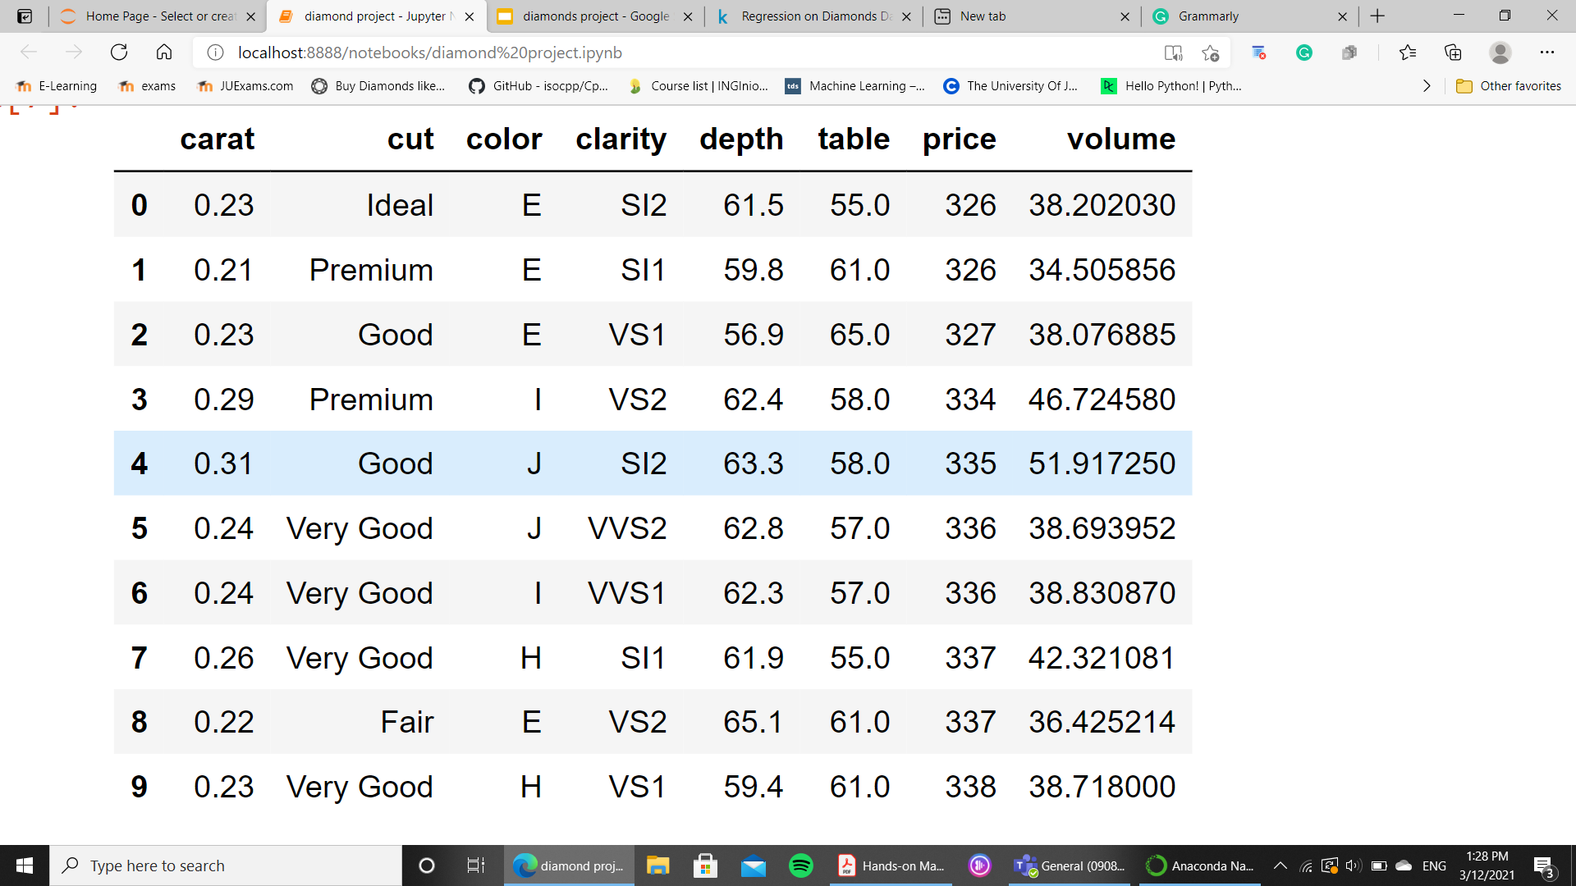
Drooping the non useful attribute
We replace the x,y,z with the volume because the depth and the table are a shape attribute and the volume have a better correlation with the price also we dropped the unnamed:0

Slide 21
Splitting the data set
Train set 0.8
Test set 0.2

Slide 22
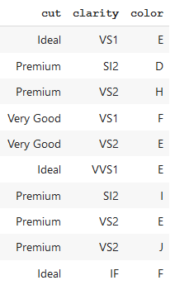
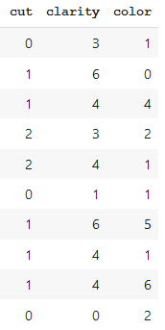
Manual encoding for cut,clarity,color
The following two pictures present the old and new columns values

Slide 23
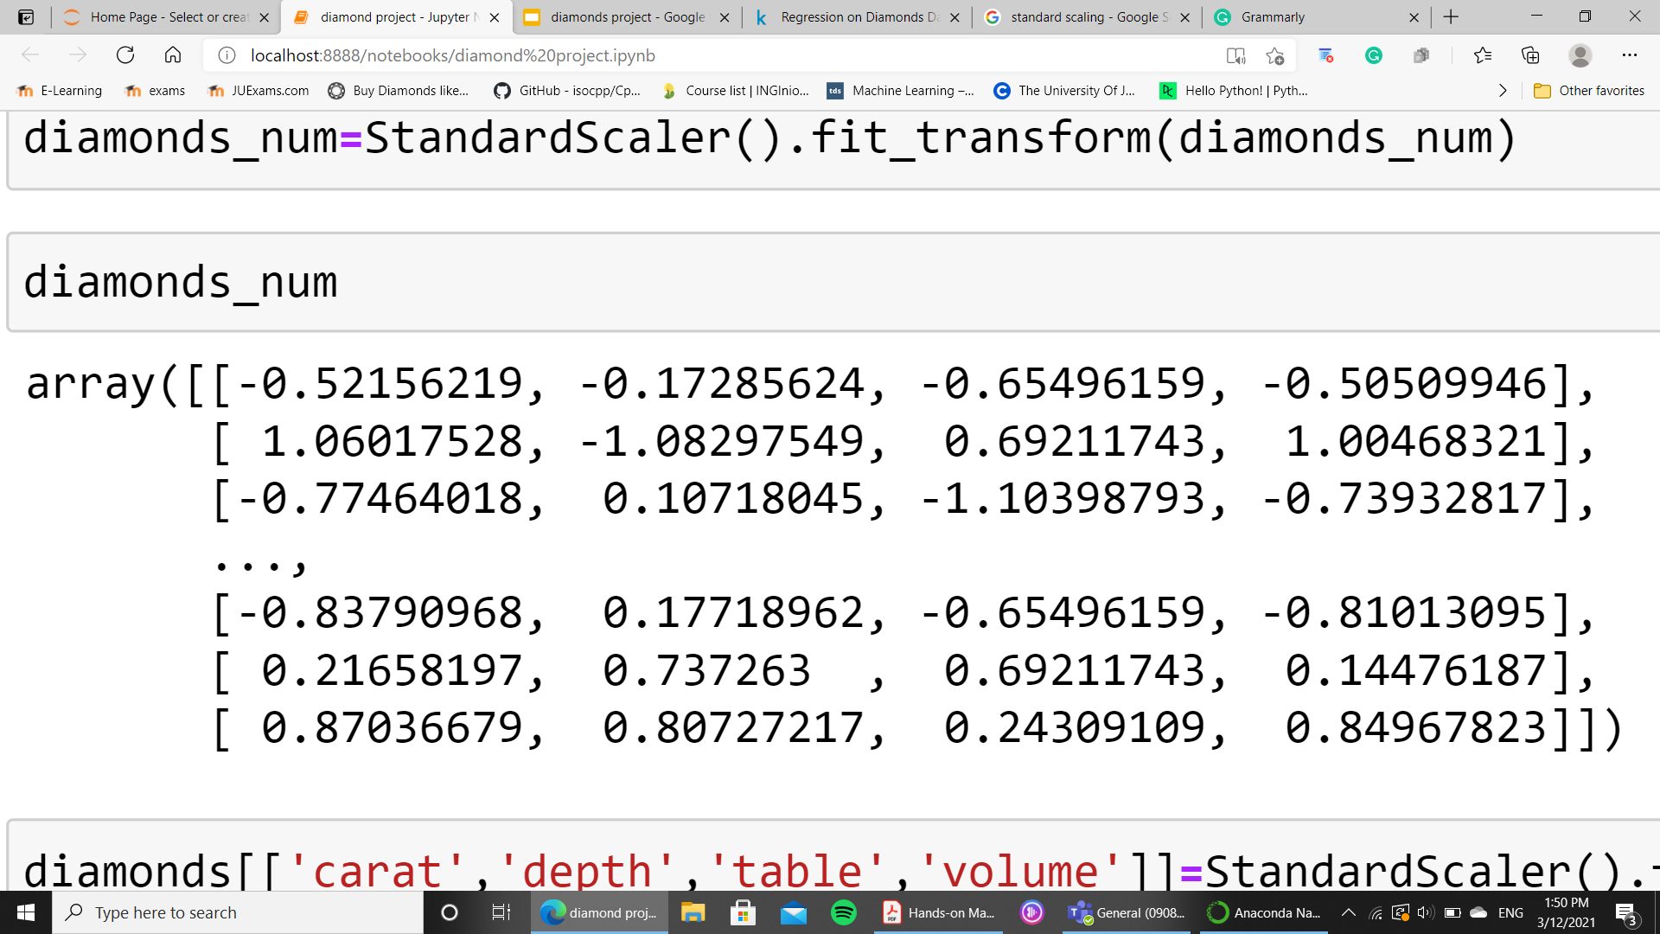
Feature scaling
We did a standard scaling on the numerical data to improve the machine learning algorithms performance

Slide 24
Select and Train the Model

Slide 25
Comparison between classification algorithms results
algorithm | rmse
LinearRegression | 1242.69218489573
DecisionTreeRegressor | 33.4313580541933
RandomForestRegressor | 206.2625872560424
It is not necessarily true maybe the module just overfit the data let us do cross-validate to be sure

Slide 26
Cross validation
Cross validation algorithms | Mean rmse
LinearRegression | 1359.5567454665102
DecisionTreeRegressor | 731.5732317383656
RandomForestRegressor | 550.2302377104281
As expected.

Slide 27
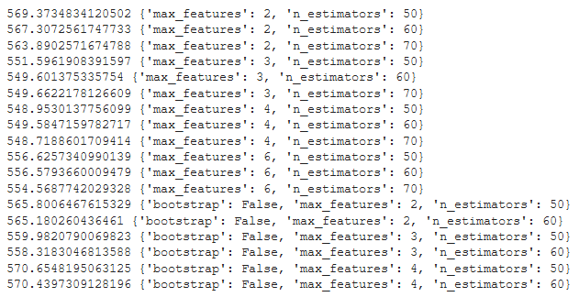
Model Selection using GridSearch
We used gridsearch to select best model and parameters, the parameters are :
n_estimators: [50,60,70] max_features: [2,3,4,6] bootstrap: [False] n_estimators: [50,60] max_features: [2,3,4]
The following figure represents the result of parameter selection with their rmse.

Slide 28
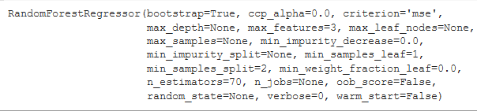
Best model
The best model depending on gridsearch is in the following figure, where the max feature: 4 and n_estimator: 70
And the result of predict the test data using this final model is: 516.1885712676707

Slide 29
Thank you

